Slide 1
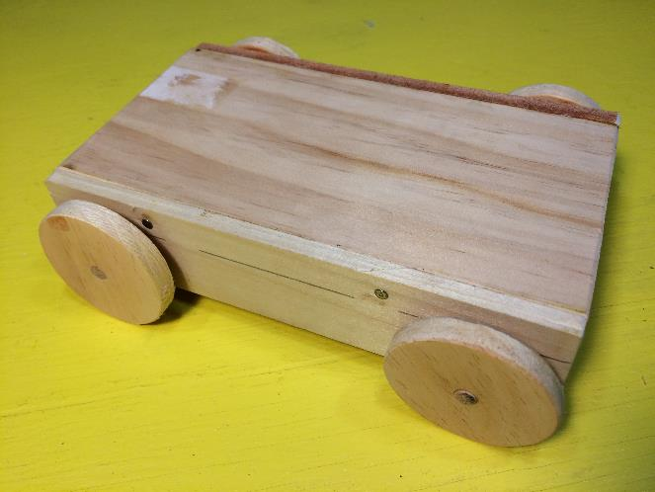
Building an Experiment Cart
LabRat Scientific
© 2018

Slide 2
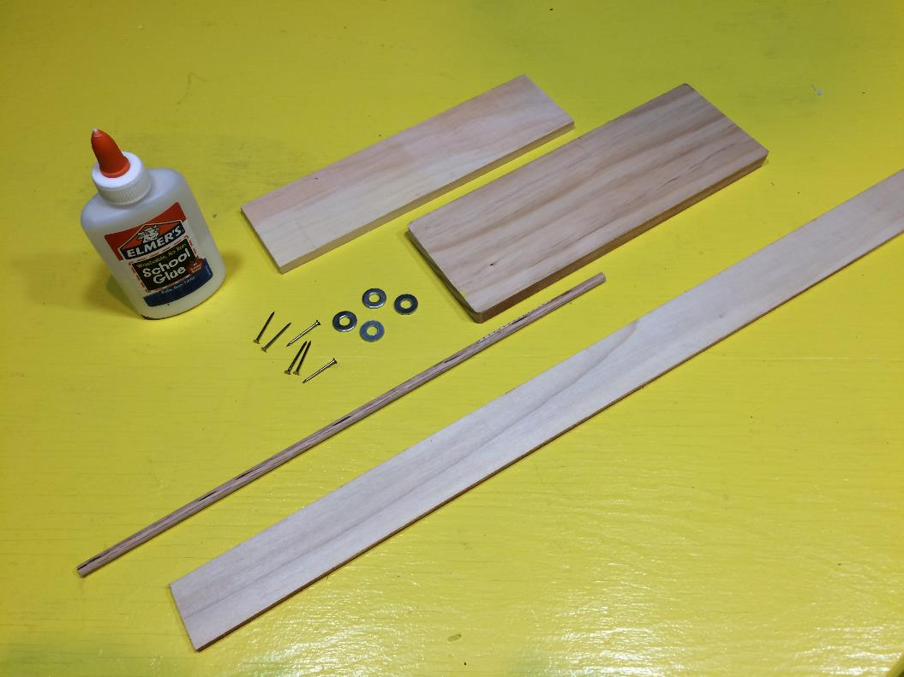
Materials
White Glue
Craft Board
2.5” wide x 3/8” thick
Small Nails (6 ea)
Craft Board
3.5” wide x 1/2” thick
Washers (4 ea)
Wooden Lattice
¼” dia Wood Dowel

Slide 3
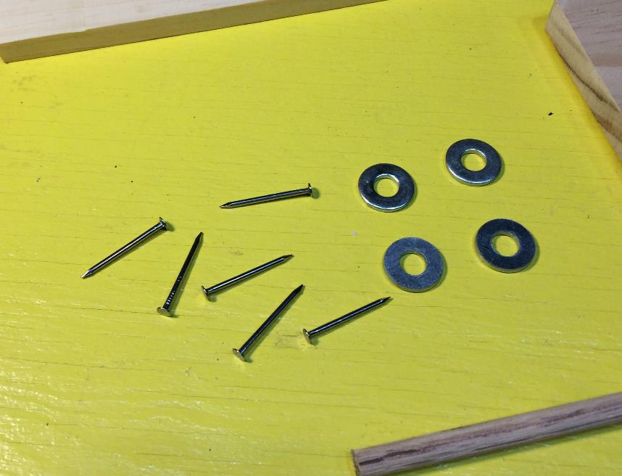
Materials
Keep the nails fairly small so they don’t split the wood when installed. They should be about ¾” long.
The center hole in the metal washers should be large enough to accept the wood dowel with excess clearance.

Slide 4
Materials
All of these materials can be bought at home improvement stores such as Home Depot or Lowes. The can also be easily purchased from smaller local home improvement stores.
There is nothing especially critical about the materials. Oak dowels are generally best because they tend to be stronger and straighter. Craft boards are generally higher quality wood and available in smaller sized. 1/4" to 3/8” thick boards are optimal for this project.

Slide 5
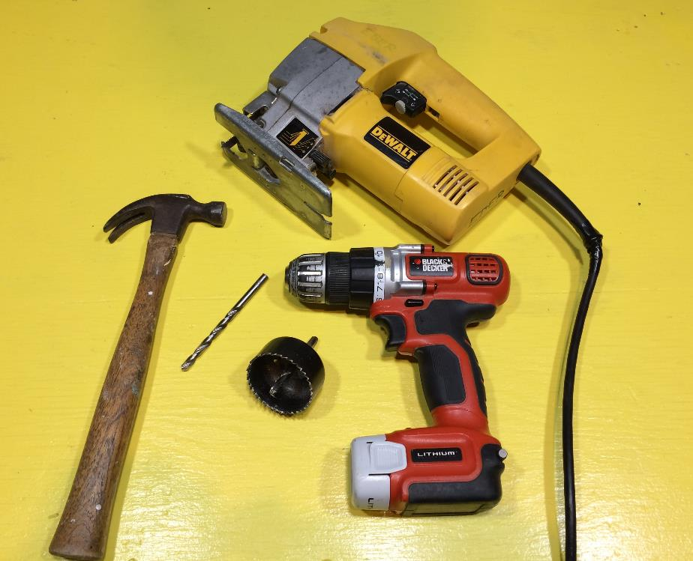
Tools
Hammer
Jig Saw
3/8” Drill Bit
Hand Drill
2” Dia. Hole Saw

Slide 6
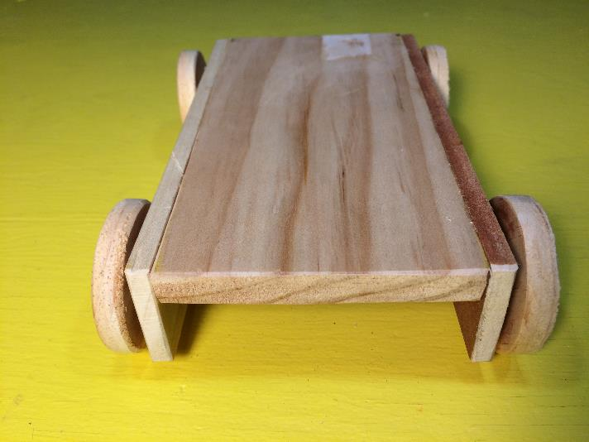
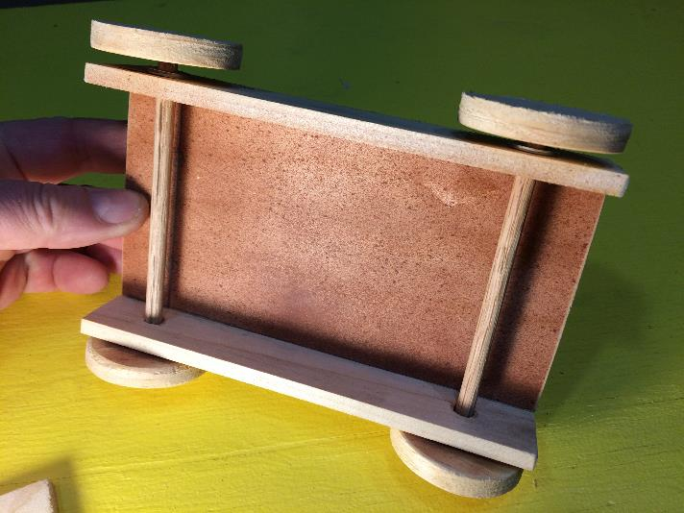
Cart Configuration
This is what the cart will look like once it is completed. Blocks, rubber bands, springs and other things can be easily attached to the top of the cart to accommodate the particular experiments being conducted.

Slide 7
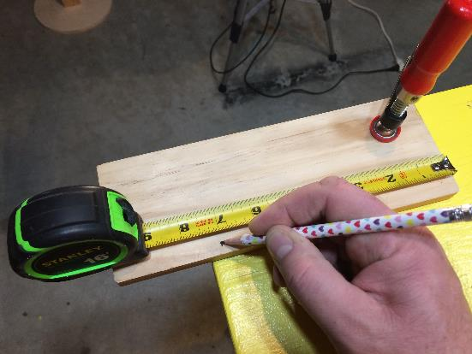
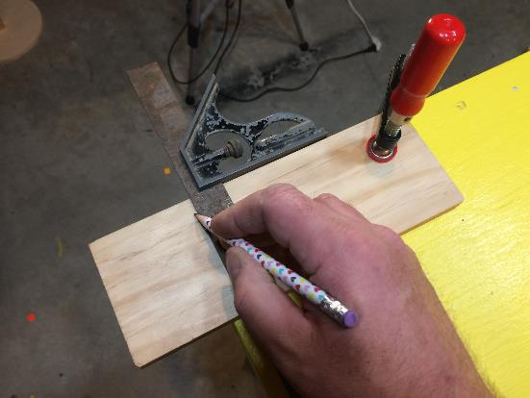
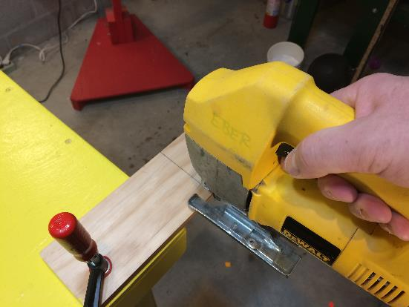
Main Cart Body
This example cart is 7 inches long. Mark the 3.5” wide craft board.
Use a square to make a straight cut line.
Cut with a jig saw

Slide 8
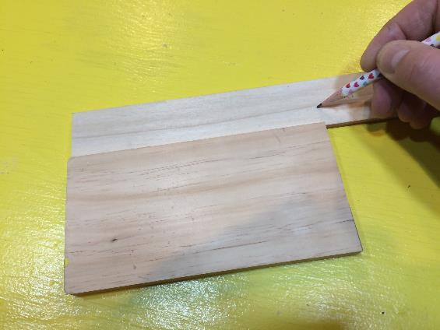
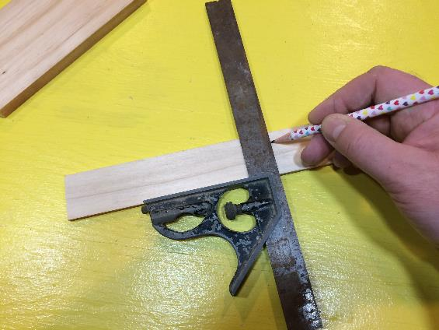
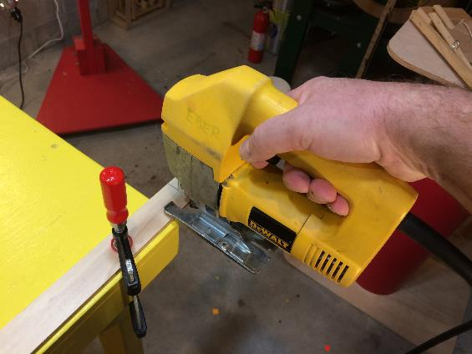
Side Rails
Make the side rail the same length as the main body. Mark the length on the lattice board.
Mark a cut line.
Cut.

Slide 9
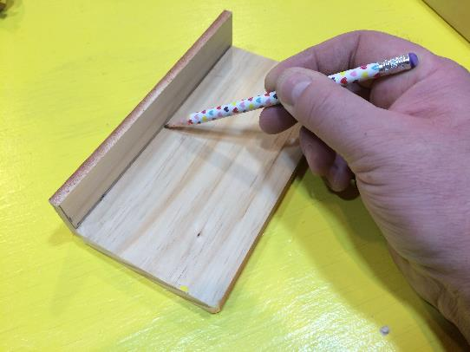
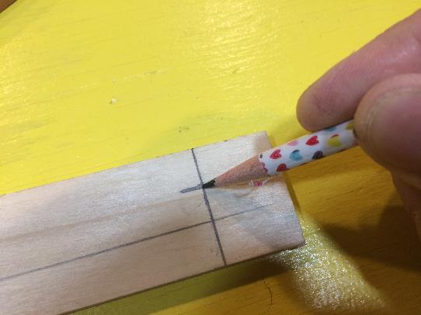
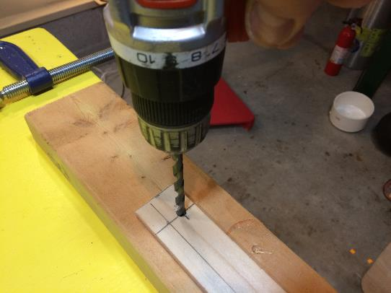
Axel Holes
Mark the body thickness on the side rail.
Mark hole locations on the side rail. 1” from end of rail and half way between rail edge and body thickness line.
Drill holes – make then oversized so the ¼” axle rotates freely.
Note: Stack the two side rails and drill both at the same time. This will help ensure the holes are symmetrical and reasonably aligned.

Slide 10
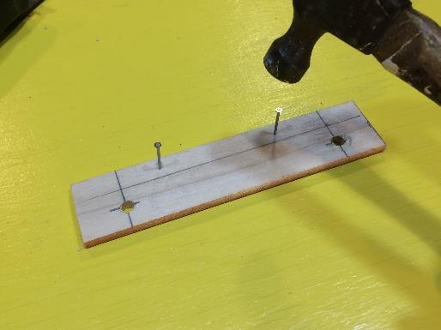
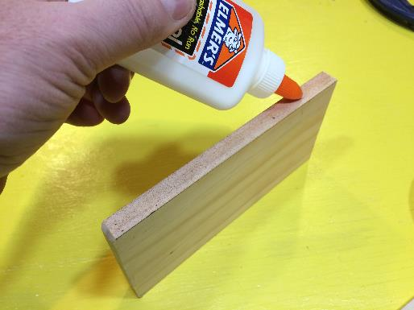
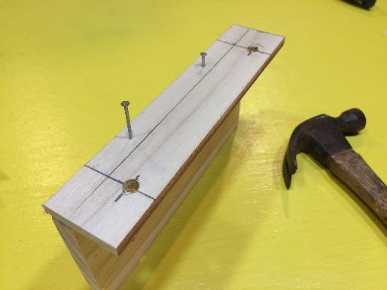
Attaching Side Rails
Align the side rails and nail.
Pre-start 2 (or 3) nails on each side rail.
Apply some glue to the edge of the cart body.

Slide 11
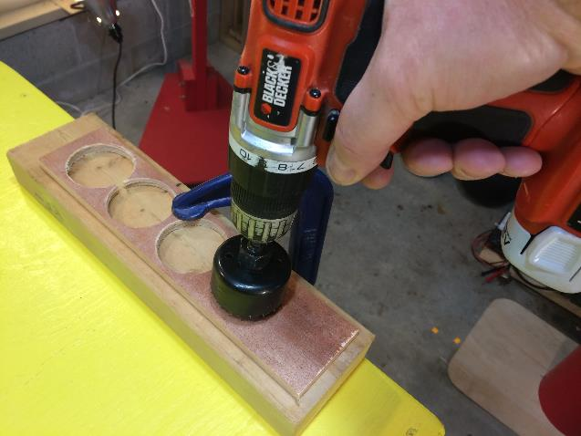
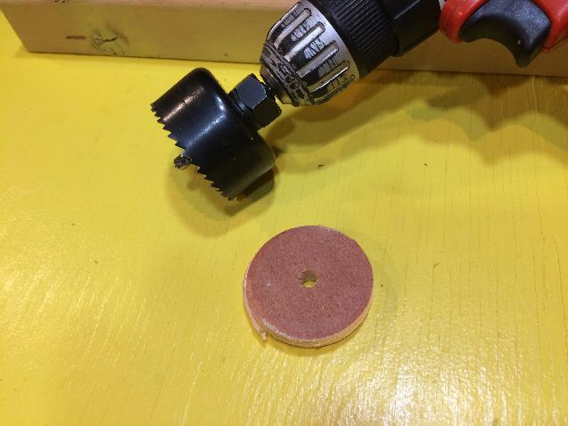
Cutting Wheels
Use the 2” dia hole saw to cut the 4 wheels out of the 2.5” wide craft board.
Make 4 wheels. Sand each smooth being careful not to make flat spots.

Slide 12
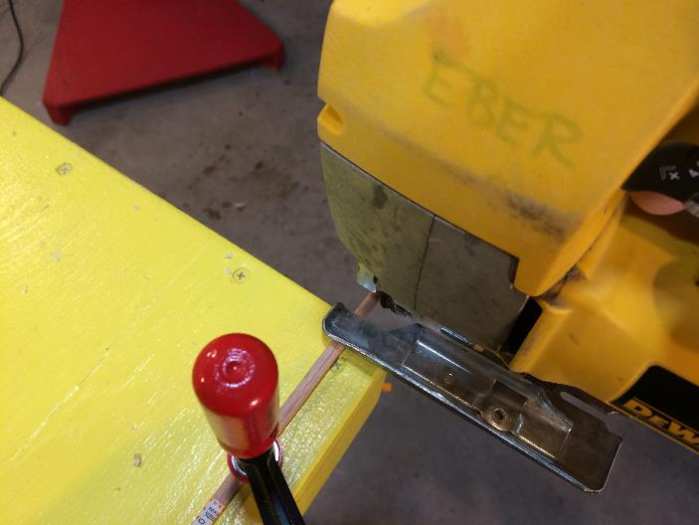
Cutting Axles
Cut the two axles longer than needed. Axle length = board width + side rail thickness + side rail thickness + wheel thickness + wheel thickness + 0.5 inches). Cut with jig saw.

Slide 13
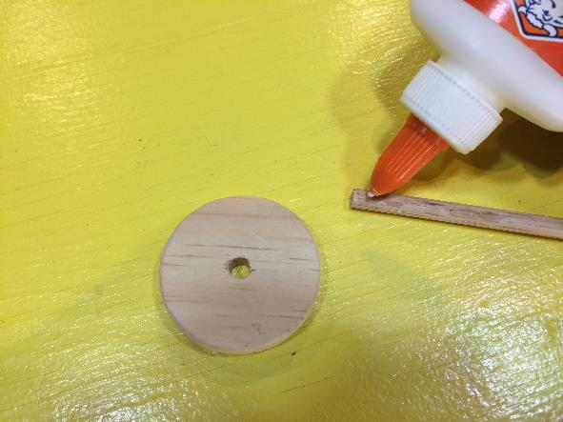
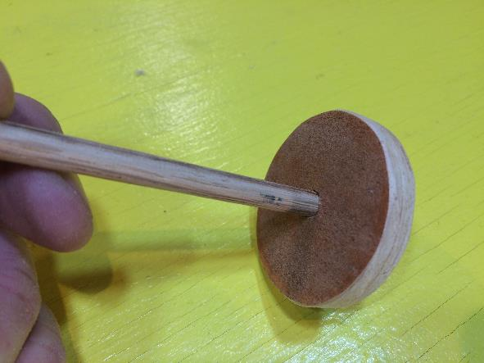
Attaching Wheels to Axles
Apply a dab of glue to the end of the axle.
Insert axles into the wheel. Make sure the axle is perpendicular to the wheel face to prevent wobbling.
Note: Attach only one wheel to each axle at this point. The other wheels will be attached after the axles are installed on the body.

Slide 14
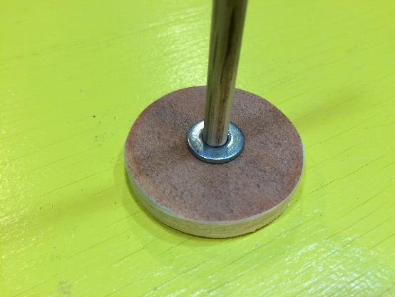
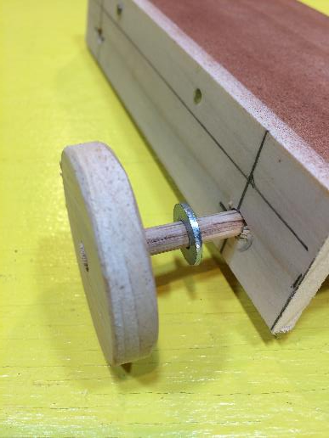
Axle Installation
Place a metal washer on the axle. This washer will reduce the surface of interaction between the wheel and sire rail.
Slide each axles through the holes in the slide rails. Make sure axle moves freely. If not, use drill to open the holes a little more.

Slide 15
Axle Installation
Do this step again for the other axle.

Slide 16
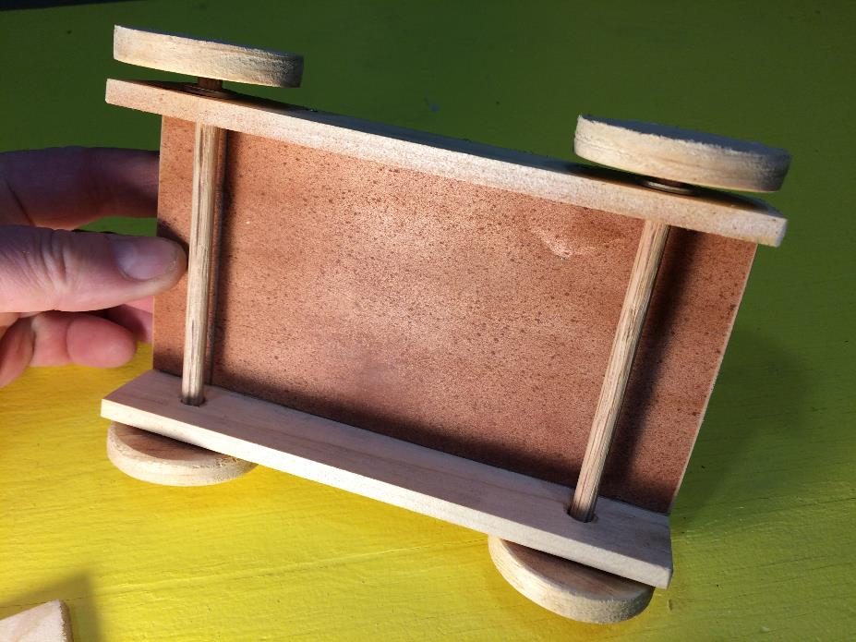
Before the final installation of the wheels, you need to ensure there is adequate spacing between the wheels and side frames.
Make sure there is a gap between the wheels and side rails. 1/8” on each side should be sufficient.

Slide 17
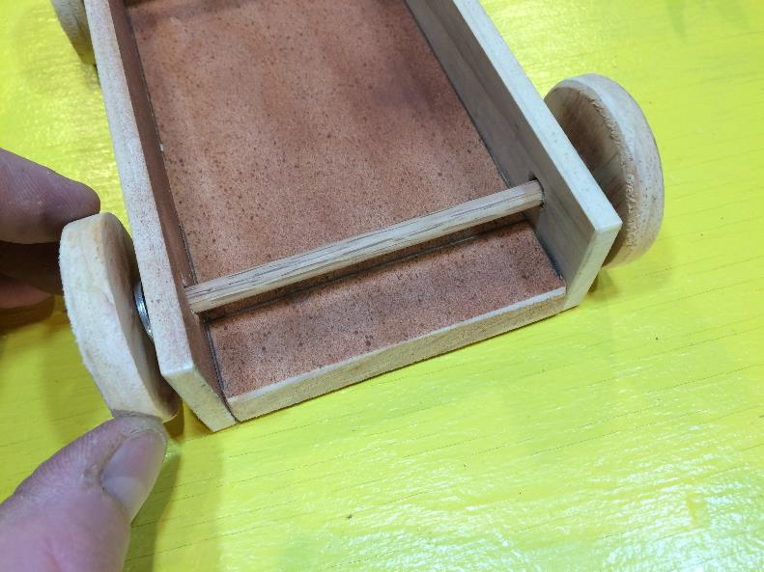
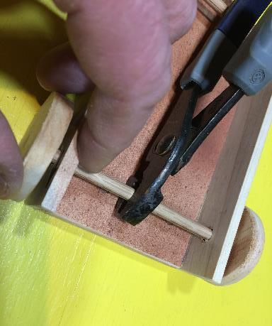
Final Wheel Attachment
You may need to grip the axles with plyers to make wheel installation easier…
Install the other washer on the end of the axle. Put a dab of glue near final position for the wheels and slip wheel onto axle.

Slide 18
Final Wheel Attachment
Repeat the installation for the other axle.

Slide 19
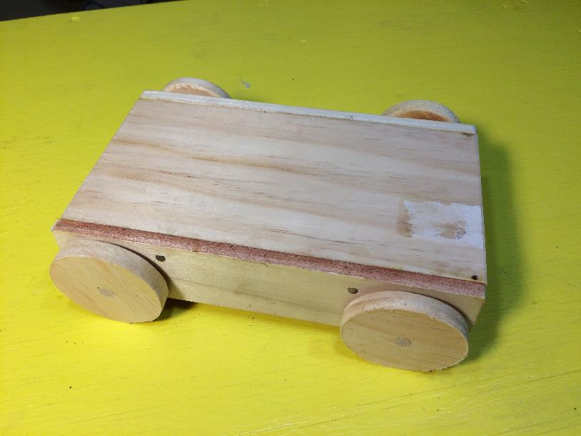
The cart is now ready to use. Apply dry graphite lubrication (available at hardware stores) to the axles where they pass through the side rails to reduce friction. Attach hardware as required for specific experiments.

